Slide 1
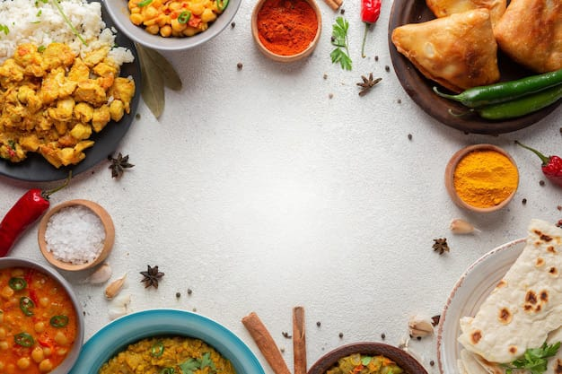
FOOD HABITS

Slide 2

RAGHU INSTITUTE OF TECHNOLOGY (AUTONOMOU)
(Approved by AICTE New Delhi,and Permanently affiliated TO JNTU-VIZ NBA and NAAC A+ Grade accredited institute)
DEPARTMENT OF COMPUTER SCIENCE AND ENGINEERING
BATCH-3
GUIDE NAME
Mr . Ravi Raj
Asst.professor,
Deparment of CSE,
Raghu Institute of Technology
TEAM MEMBERS
N.Harshitha(223J1A05C5)
N.Pujitha(223J1A05C9)
G.Sri Kavya(223J1A0571)
K.Anitha(223J1A0592)
K.Sushmitha(223J1A0583)

Slide 3
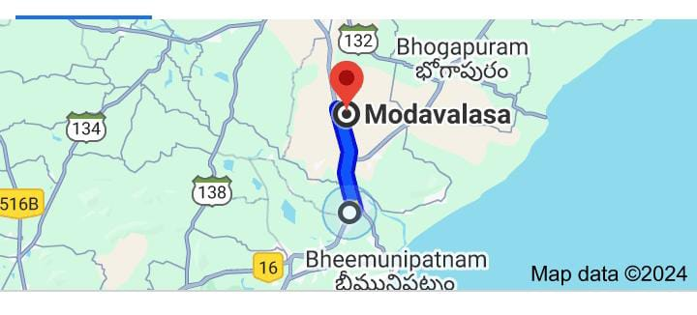
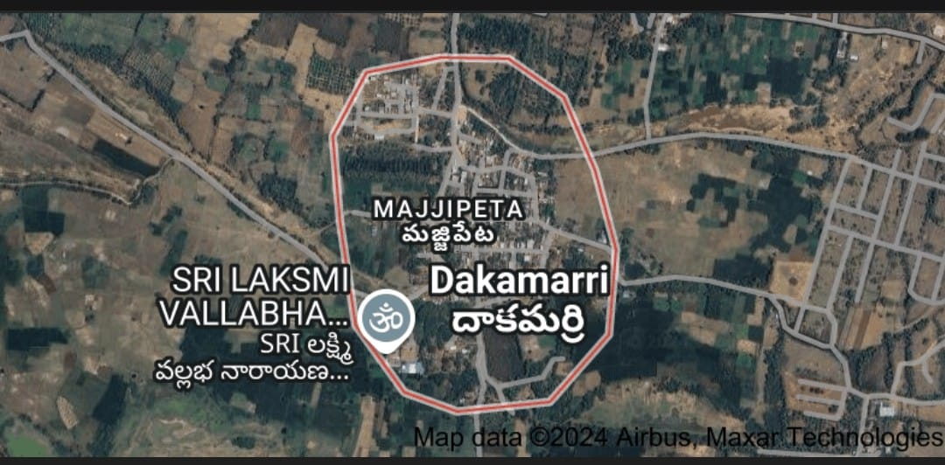

Slide 4
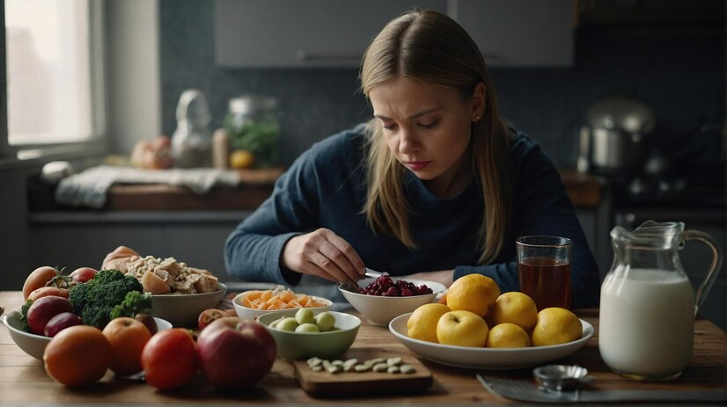
INTRODUCTION
Now-a-days when it comes to eating,
everyone has different habits.
Some of us enjoy three meals a day,
while some of us would rather enjoy
little snacks and meals spread throughout
the day.
Additionally, we also must compete with
the demands of our everyday lives affecting
our meals. You might work two jobs and
take care of children when you get home.
Maybe you have a fixed schedule some days,
but other days, a more unpredictable one.
Those situations will affect the way we eat, and at times, will push us to pick up bad eating habits. These can include eating close to bedtime, skipping meals, eating too fast, mindless eating, or stress eating.
Let’s talk about how those habits can affect your health and some suggestions for managing them.

Slide 5

Eating close to bedtime
Eating close to bedtime can affect your natural sleep cycle by decreasing the amount of rest you get. This has been associated with unwanted weight gain, increased blood pressure and increased risk of heart disease.
Things to try instead:
Eat about 2-3 hours before going
to bed..
If you find yourself hungry again
after dinner, opt for a light snack
such as a yogurt or a piece of fruit.
If you're not able to fit in a
full meal 2-3 hours before your
bedtime and need to eat closer
to your bedtime, try a smaller snack
instead.

Slide 6

Skipping meals
Missing meals can affect your mood as
your blood sugar may start to drop.
You may feel tired, have trouble
concentrating, or feel dizzy and irritable.
Additionally, it may make you more
prone to overeat at your next meal or
increase cravings for high fat and high
sugar foods because you feel so hungry.
Things to try instead:
Meal planning can be helpful when you don't have time to cook for yourself on a daily basis. There are different ways to meal prep – it doesn't have to be done all on one day for the entire week. You can make a grain and a protein (chicken and rice, for example) and throughout the week add various seasonings for some variety. Using pre-cut vegetables or frozen vegetables can cut down on the time it takes to prepare and cook food.

Slide 7
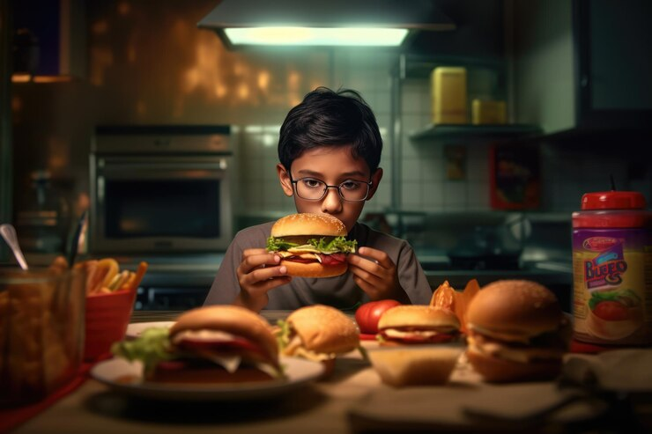
Eating too fast
Eating quickly makes it difficult to know when you are full.
This can lead to overeating, indigestion, heart burn and
unwanted weight gain.
Things to try instead:
Use smaller utensils to take smaller bites (such as a dessert fork or spoon)
and put down your utensils between bites.
Sip a calorie-free beverage, like water,
sparkling water, or unsweetened tea between bites.
When possible, eating with others, relaxing and having a
conversation over a meal can help slow down your eating.
Mindless eating
Mindless eating can lead to overeating and unwanted weight gain
. It also can be a sign of stress or other emotional burden.
Things to try instead:
Eat at a designated spot, such as your kitchen table, rather than in front of the TV.
Practice paying attention to the smell and flavor of your food, its appearance and the sensations you feel while eating.
If you like to track and compare things, keep a journal of what you’re eating and when you eat. This can make you aware of your eating habits.
When you eat, ask yourself if it’s because you’re hungry or if it’s out of habit or boredom.

Slide 8
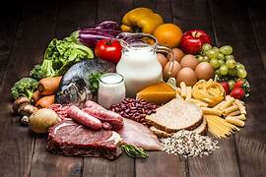
TYPES OF FOODS:
Vegetables
Fruits
Meat and Poultry
Grains beans and nuts
Fish and seafood
Dairy foods
Proteins

Slide 9
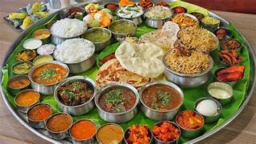
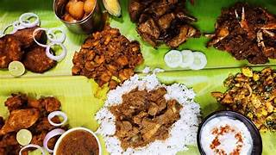
LOCAL FOODS OF ANDHRA PRADESH :-
Gutti Vankaya Kura
Mudda Pappu with Avakai And Ghee
Ulava Charu
Gongura Pachadi
Pulihora
Kodi Pulao
Gongura mutton
Natu Kodipulusu
Chilli Chicken
SOME VED FOOD ITEMS IN ANDHRA PRADESH :-
1.Paneer
2.Sweet Potatoes
3.cucumber etc
SOME NON-VEG FOOD ITEMS IN ANDHRAPRADESH:-
1.Chicken
2.Mutton
3.Fish etc

Slide 10
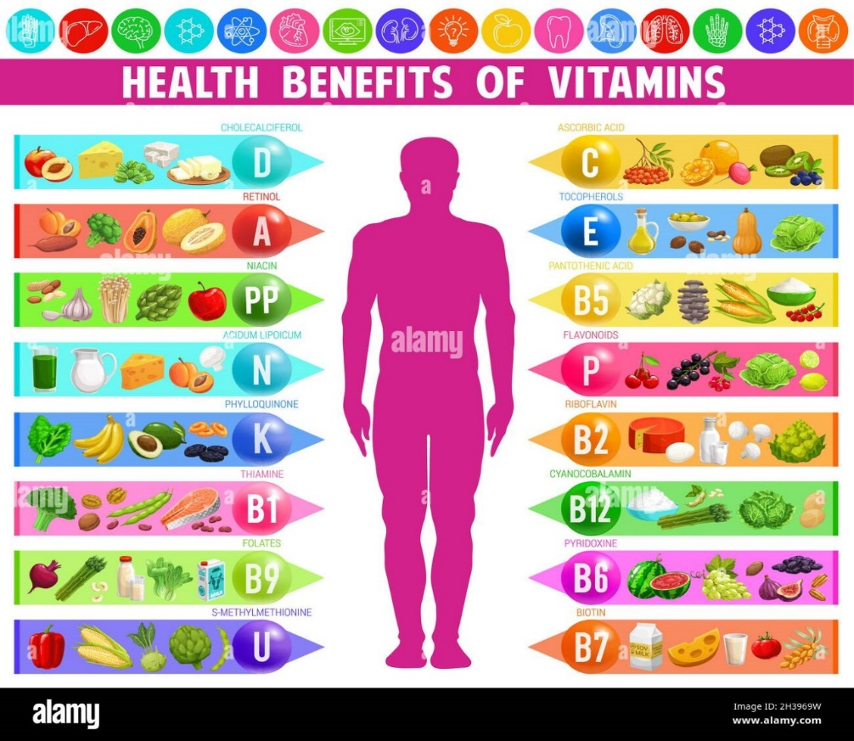
VITAMINS
Definition :- A nutrient that the body needs in small amounts to function and stay healthy.
Sources of vitamins are plant and animal food products and dietary supplements
Types of vitamins :-
A. Fat Soluble
B. Water Soluble
Fat soluble :- Fat-soluble vitamins are absorbed
along with fats in the diet and are stored
in the body's fatty tissue and in the liver.
They are found in many plant and animal foods
and in dietary supplements.
Types of fat soluble :-
Vitamins A, D, E,
and K
Water soluble:- A vitamin that can dissolve in water.
Types of water soluble :-
Non B-Complex(vitamin c)
B-Complex

Slide 11
VITAMINS | SCIENTIFIC NAME | RESOURCES | DEFICIENCY DISEASES | SYMPTOMS
Vitamin A | Retinol | Leafy vegetables, carrot, tomoto pumpkin, papaya, mango, meat, Fish, egg, liver, milk , cod liver oil , shark liver oil. | Eye , skin diseases | Night blindness , Xeropthalmia , Cornea failure , scaly skin.
Vitamin B1 | Thiamine | Cereals , oil seeds , vegetables , milk ,meal ,fish , eggs . | Beri beri | Vomitings , fits , loss of appetite , difficulty in breathing , paralysis
Vitamin B2 | Riboflavin | Milk, eggs , liver, kidney , green leafy vegetables. | Glossitis | Mouth crucks at corners , red and sore tongue , photophobia , scaly skin
Vitamin B3 | Niacin | Kidney , liver, meat, egg , fish , oil seeds. | Pellagra | Dermatitis , diarrhoca , Loss of memory , scaly skin
Vitamin B6 | pyridoxine | Cereals , oil seeds, vegetables , milk , meat , fish , egg , liver. | Anaemia | Hyper irritatibility , nausca , vomitings , fits.
Vitamin B12 | Cyanocobalamine | Synthesised by bacteria present in intestine | Permicious anaemia | Lean and weak , less appetite

Slide 12
VITAMINS | SCIENTIFIC NAME | RESOURCES | DEFICIENCY DISEASES | SYMPTOMS
Vitamin C | Ascorbic acid | Green leafy vegetables, citrus fruits, sprouts. | Scurvy | Delay in healing of wounds , fractures of bones
Vitamin D | Calciferol | Liver , egg , butter , cod liver oil, shark liver oil , (Morning sun rays). | Rickets | Improper formation of bones , knocknees , swollen wrists , delayed Dentition , weak bones
Vitamin E | Tocoferol | fruits, vegetables , sprouts , meat , egg , sun flower oil. | Fertility disorders | Sterility in males , abortions in females
Vitamin K | Phylloquinone | Green leafy vegetables , milk | Blood clotting | Delay in blood clotting , Over bleeding

Slide 13
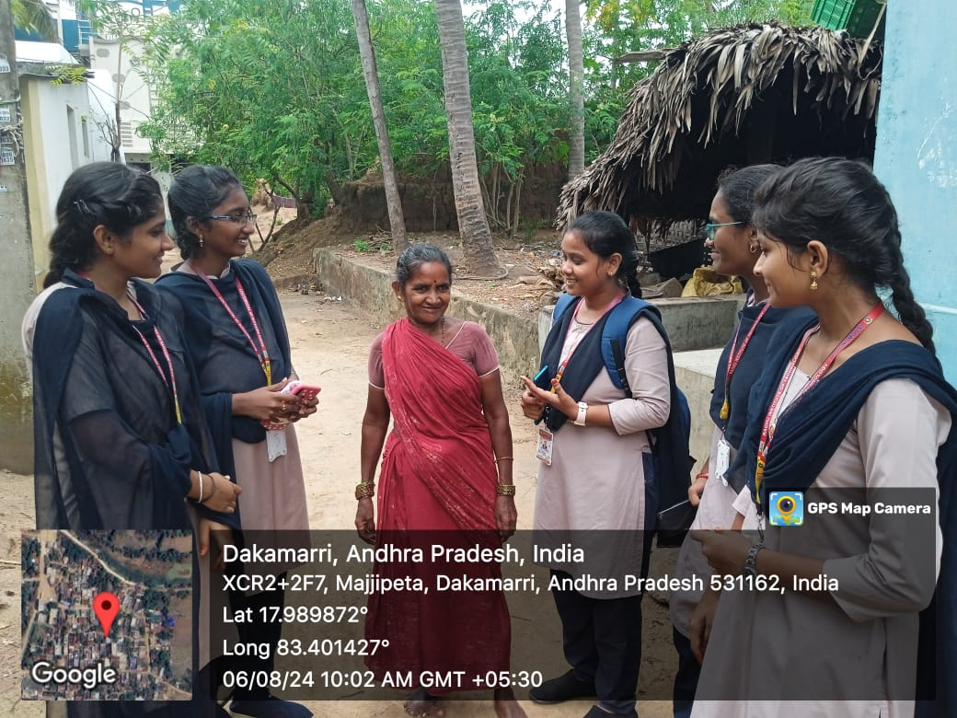
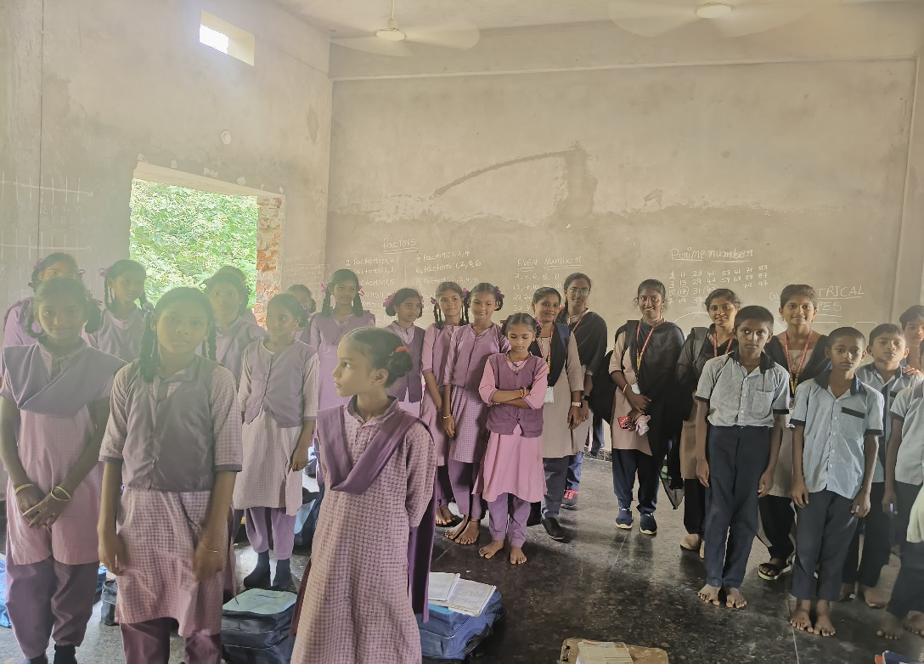

Slide 14
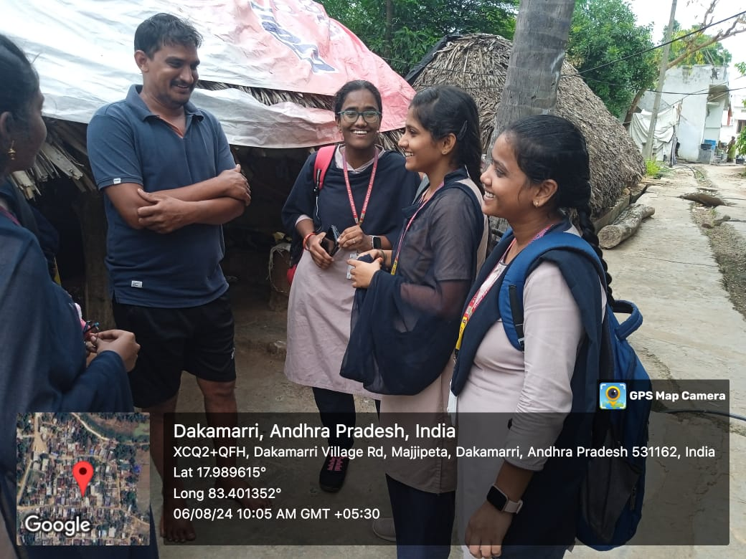
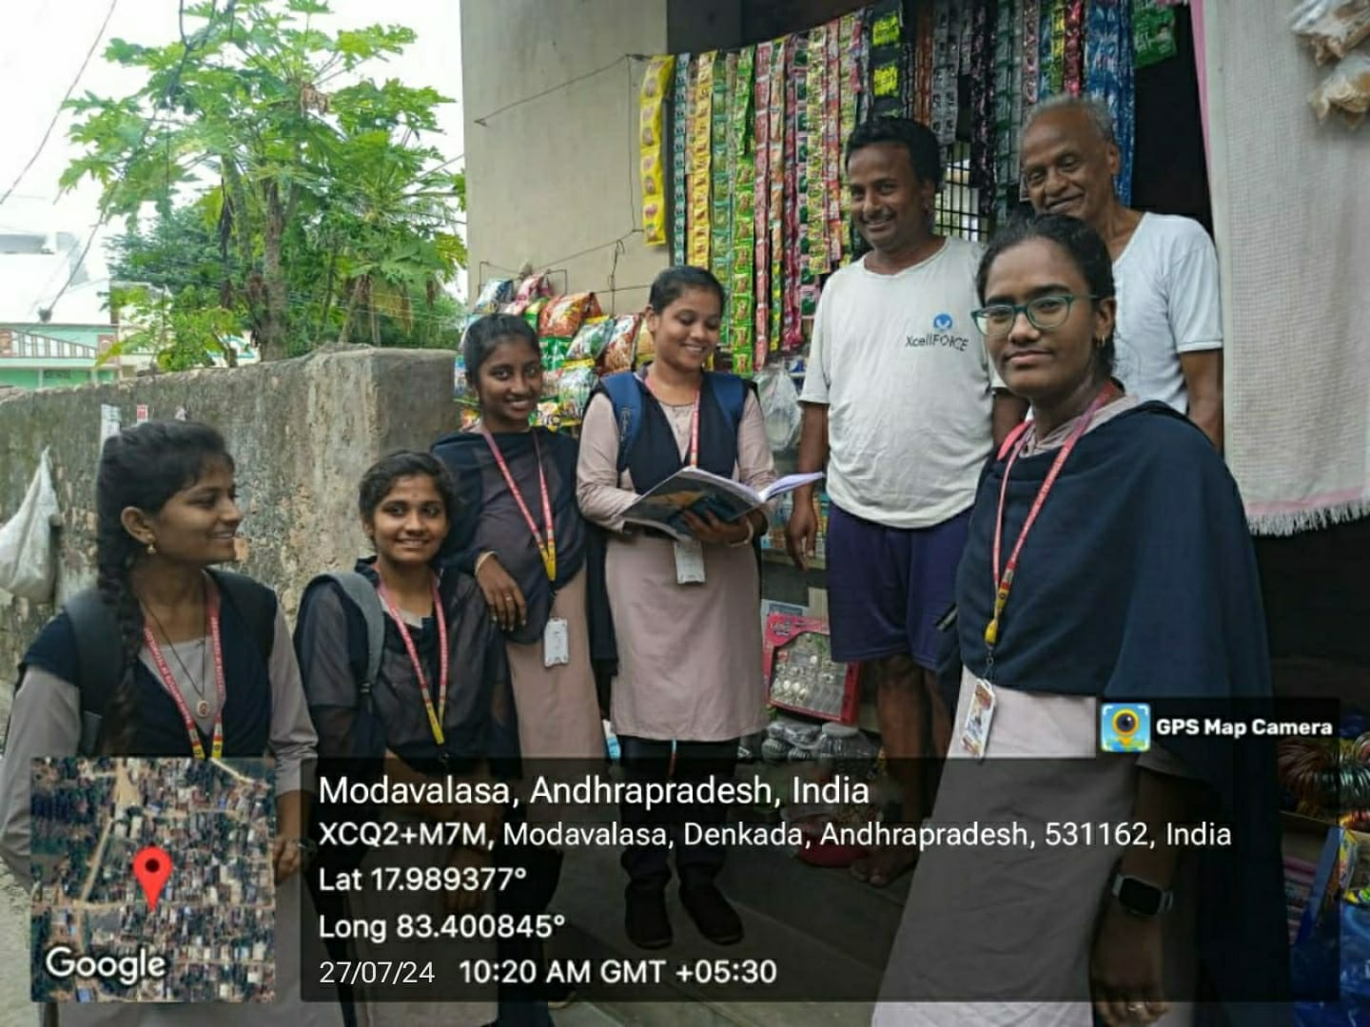

Slide 15
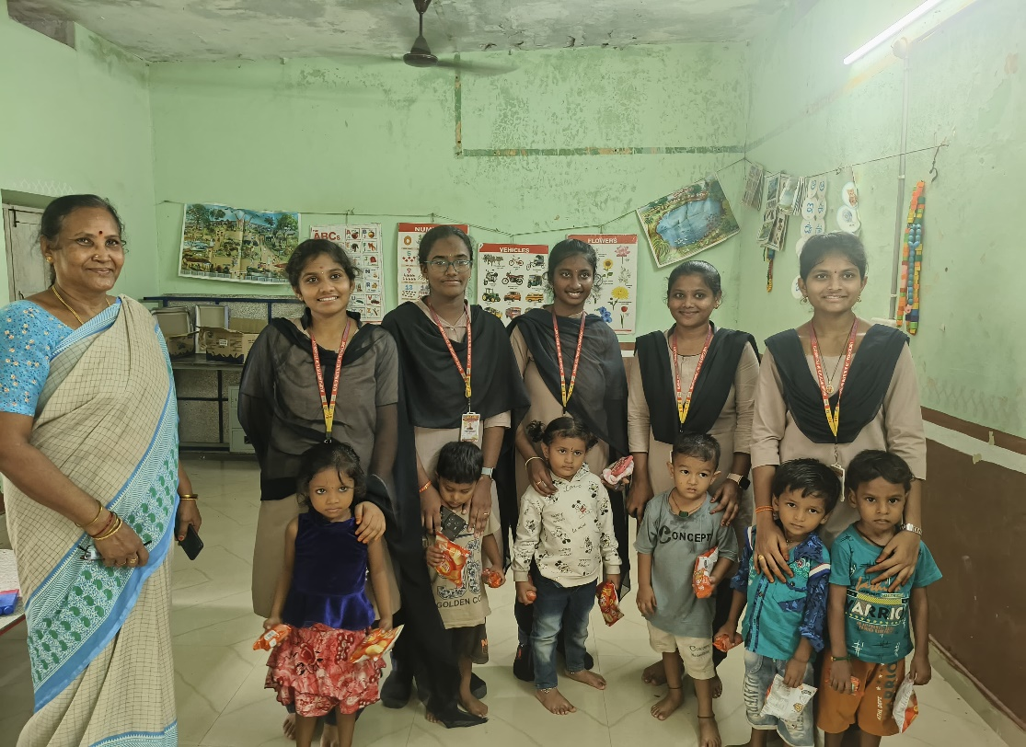
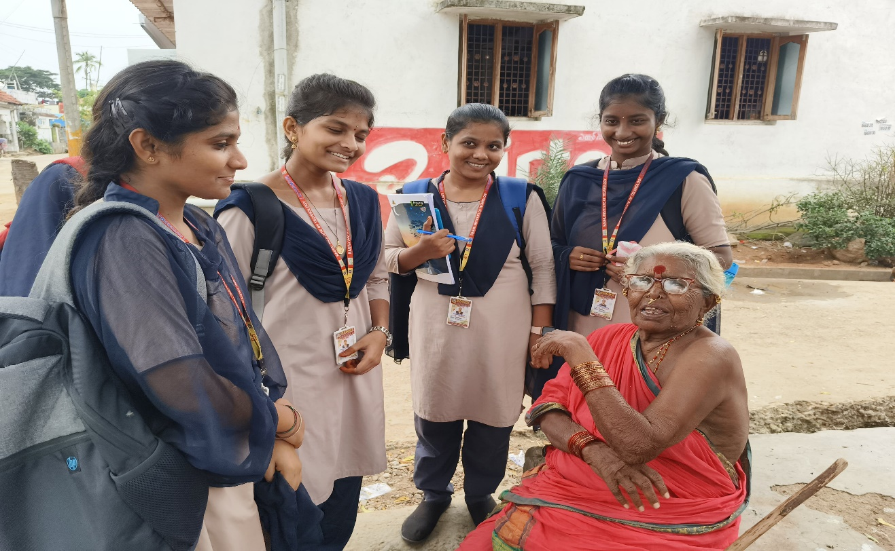

Slide 16
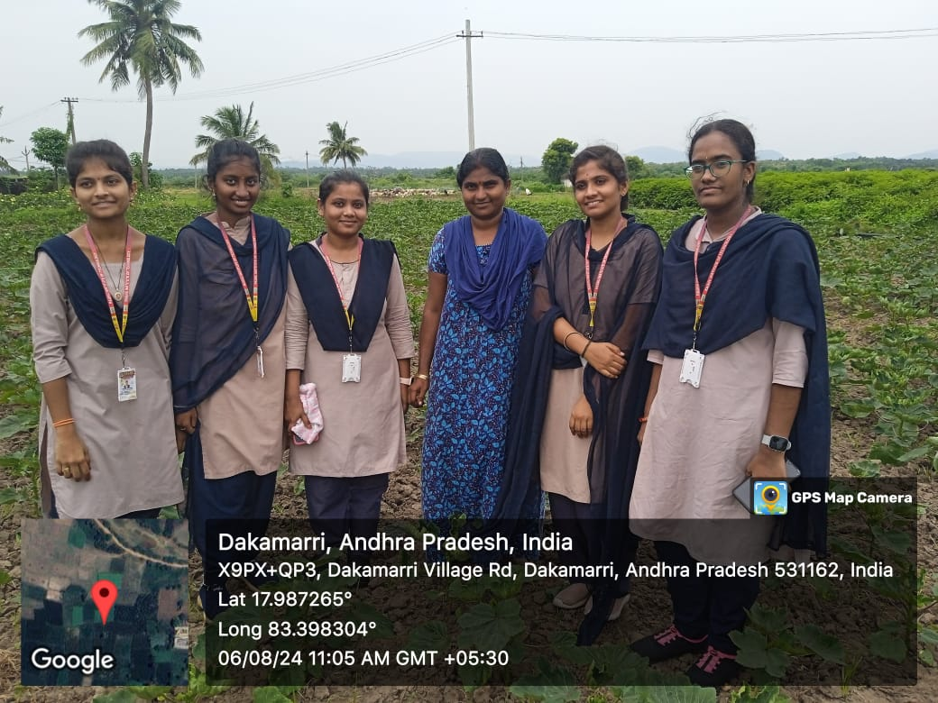
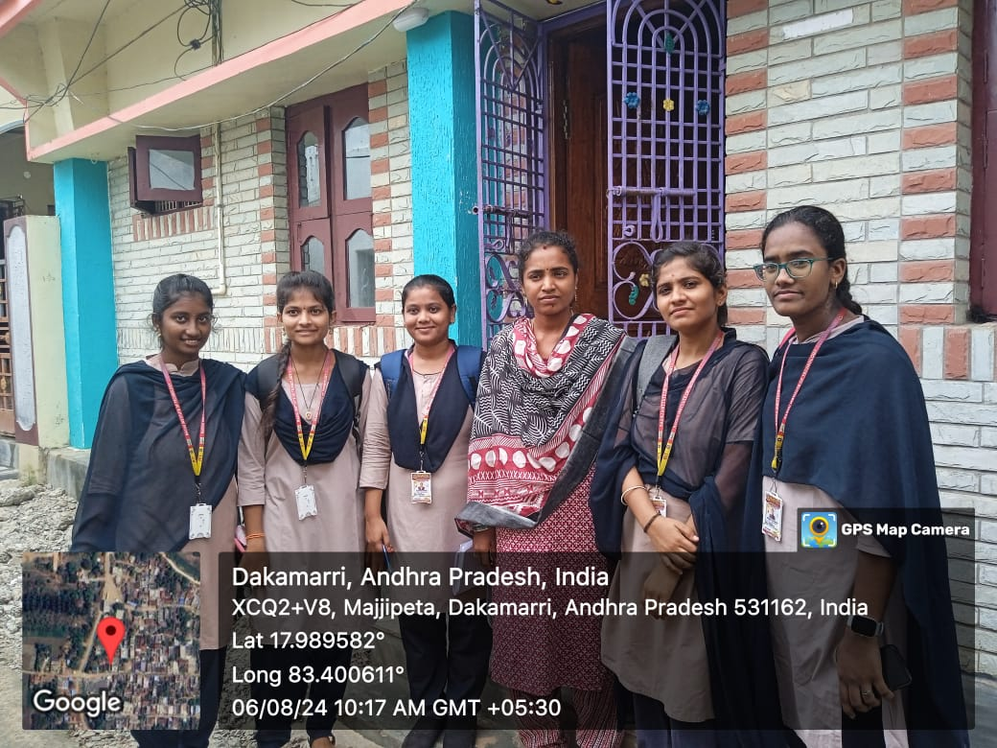

Slide 17
